Slide 1
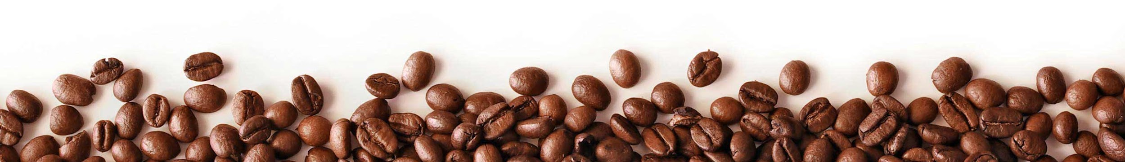
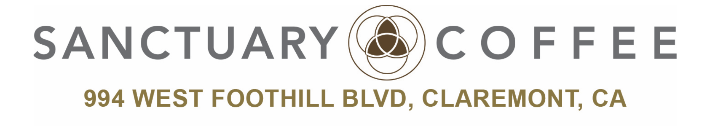
GROUP: BRONCOS

Slide 2
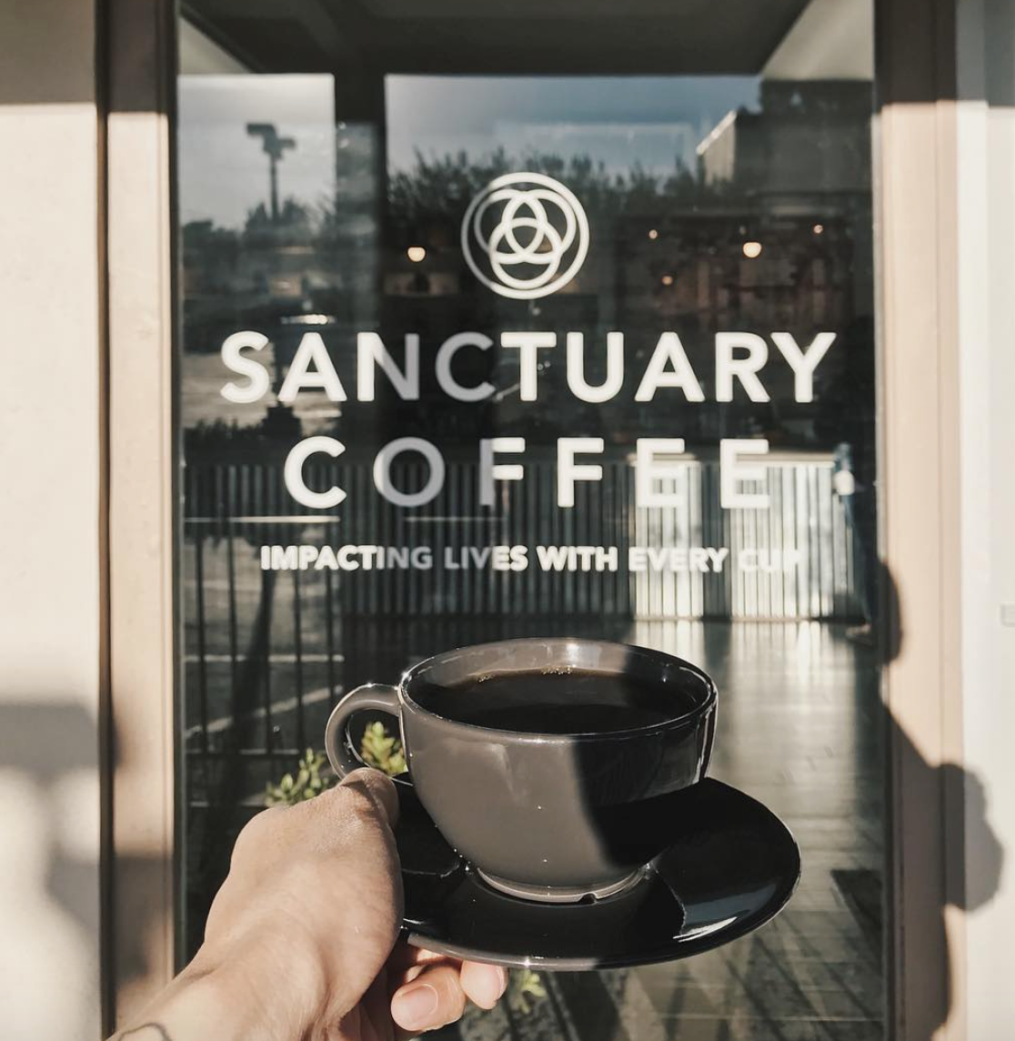
OVERVIEW
Executive Summary
Situation Analysis
SWOT Analysis
TOWS Matrix
Competitive Advantage
Marketing Goals and Objectives
Marketing Strategy and Marketing Mix
Consultation to the Business Owner

Slide 3
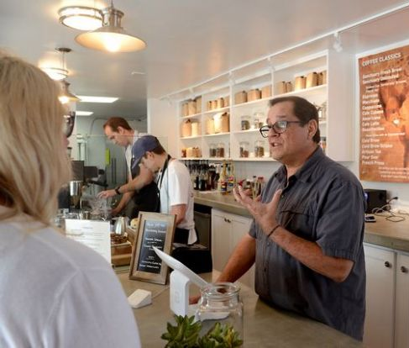
EXECUTIVE SUMMARY
Nonprofit organization located in Claremont, California
Founded by former University Dean and Professor
No desire to be the next biggest coffee shop
Wants to focus on community enhancement
Inspire others to give back to local communities
Just a front for advocating social justice
Strives to impact surrounding communities of Claremont
Build a community with those who share the same vision

Slide 4
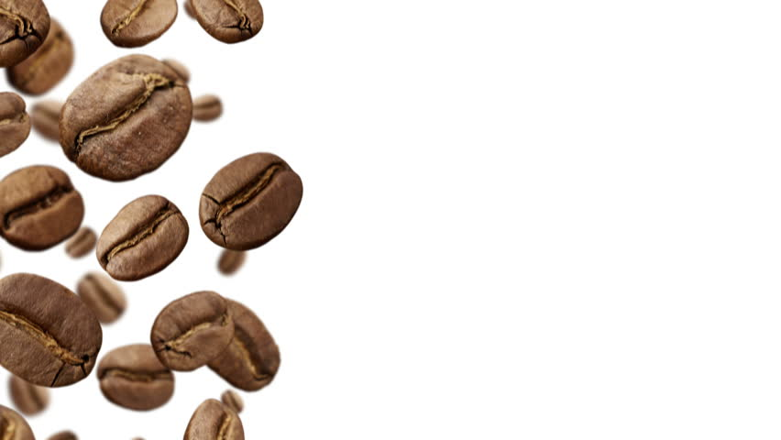
SITUATION ANALYSIS

Slide 5
INTERNAL

Slide 6
CUSTOMER

Slide 7
EXTERNAL

Slide 8
SWOT ANALYSIS

Slide 9
SWOT

Slide 10
TOWS MATRIX

Slide 11
COMPETITIVE ADVANTAGE

Slide 12
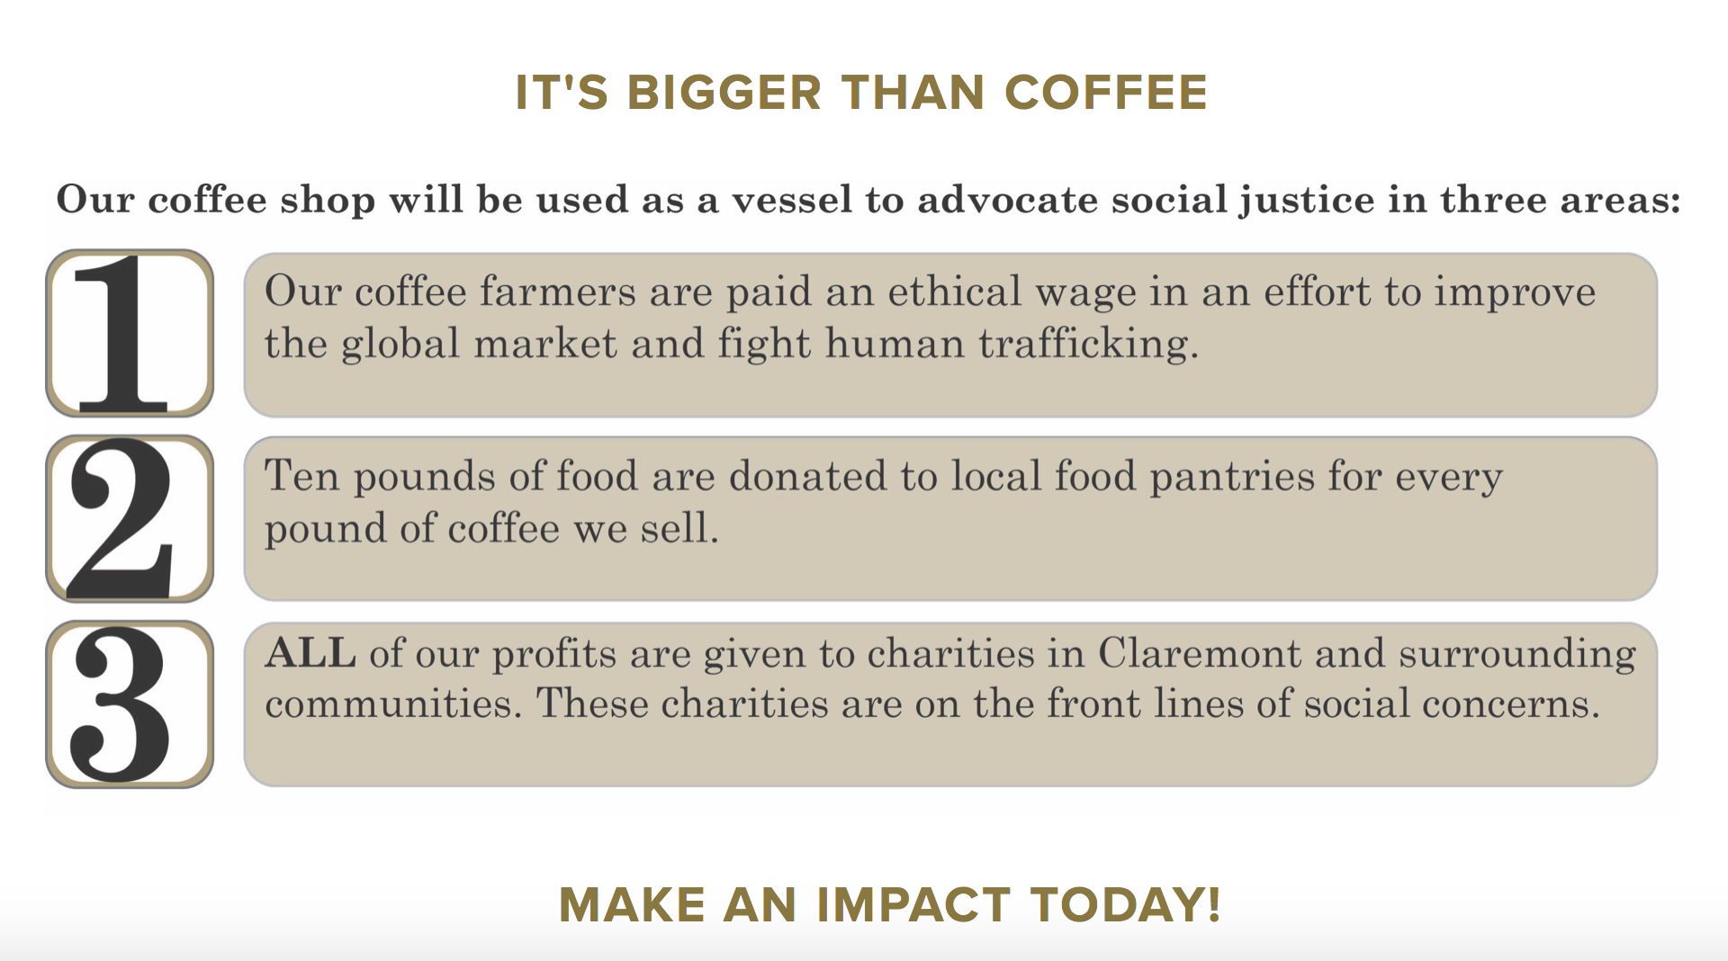
MARKETING GOALS AND OBJECTIVES
Goal is to impact lives with every cup
More than just a coffee shop
Reconcile social injustice
Planted in a community that is fairly affluent and next to a community that is in need
Inspire others to be a part of the movement
Keep people in longer to build relationships
Customers are more important
Make customers aware of community needs

Slide 13
MARKETING STRATEGY
AND
MARKETING MIX

Slide 14
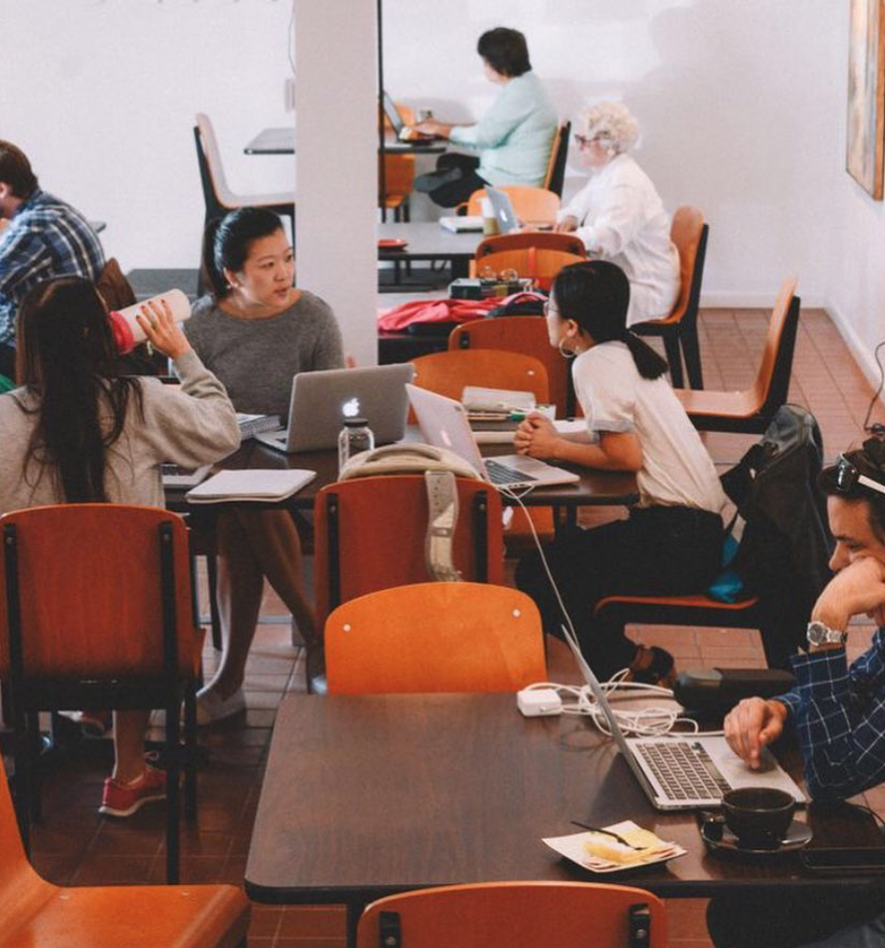



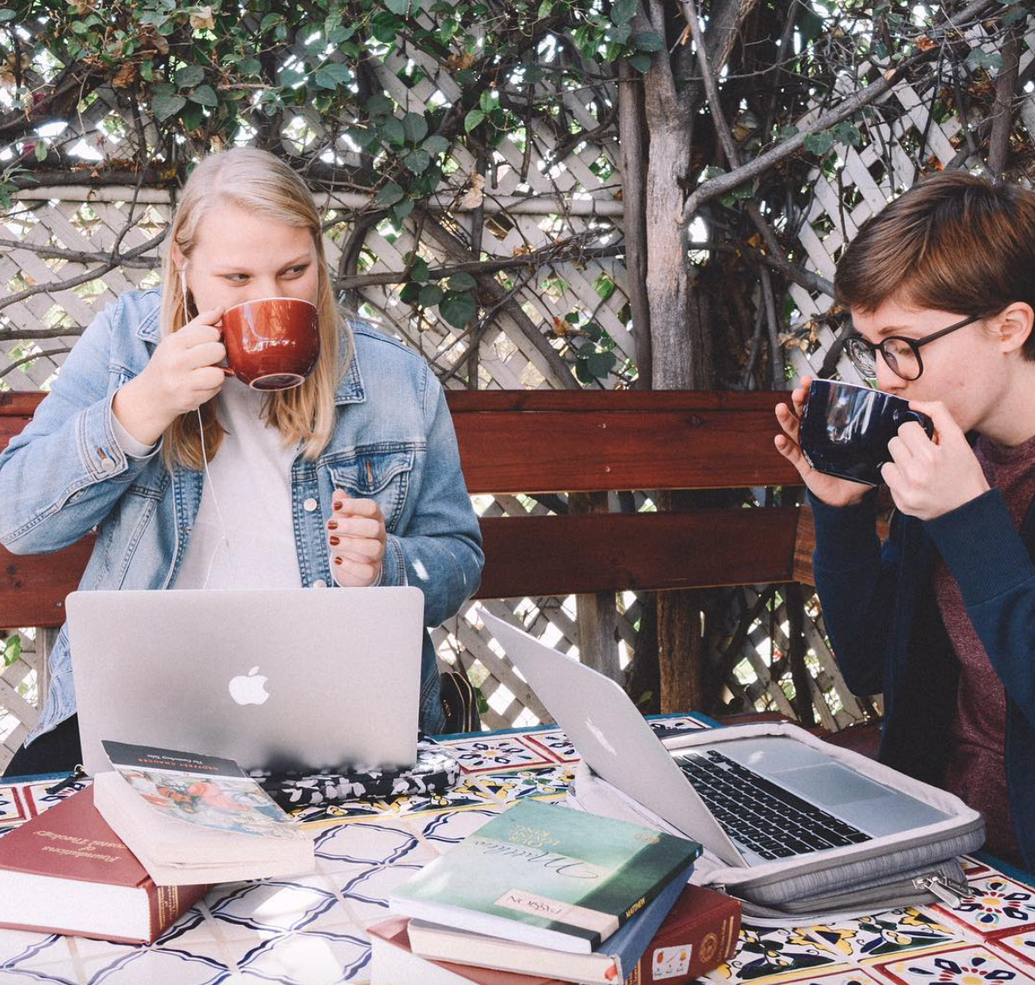

TARGET MARKET
The primary target market are millennials.
College students
  University of La Verne
  Claremont College
  Western University
  Cal Poly Pomona
Young professionals in their 20’s
The secondary target market are:
High school students
Senior citizens

Slide 15
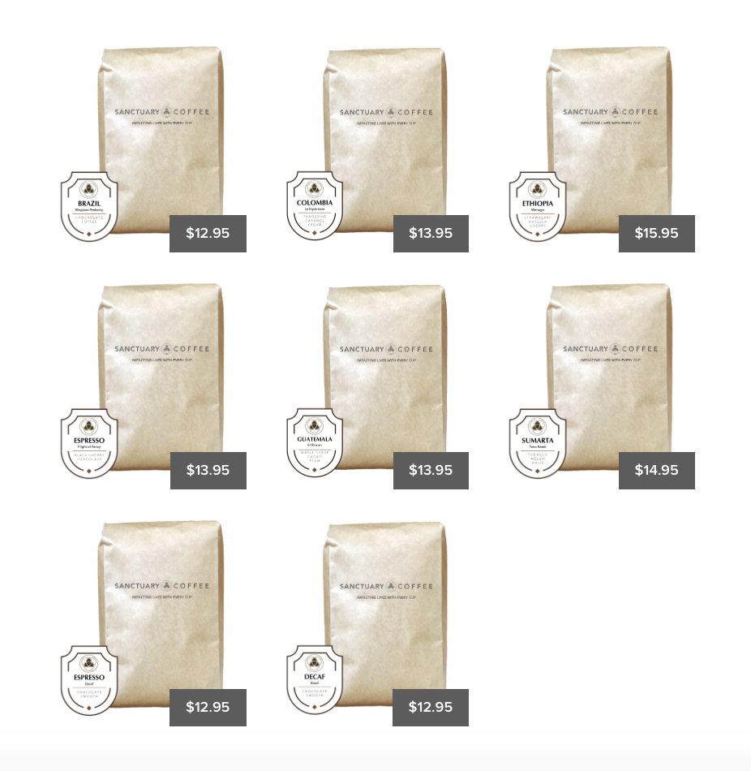
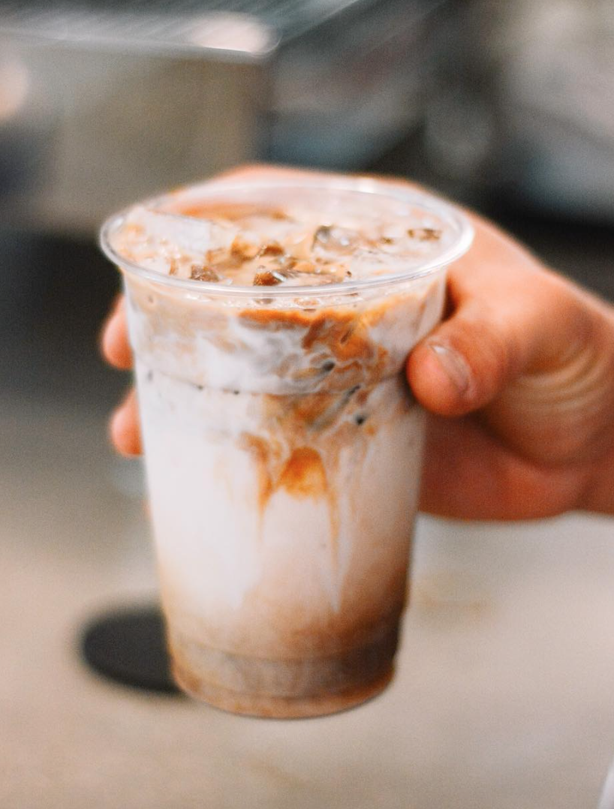
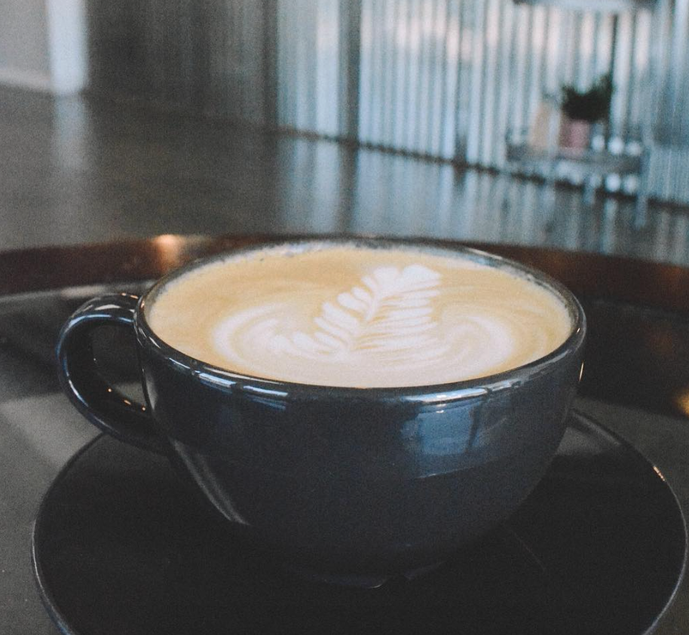
PRODUCTS
PRICE
Coffee Classics
Fresh Brew
Espresso
Macchiato
Cappuccino
Americano
Artisan Tea
Specialty Coffee
Flavored Latte
Creme Brûlée Latte
Cinnamon Mocha Latte
Specialty Drinks
Chai Tea Latte
Dirty Chai
Green Tea Mint Latte
Tonic Water
Sanctuary Coffee Beans
Brazil: Mogiana Peaberry
Colombia: La Esperanza
Ethiopia: Wenago
Espresso: Flight of Fancy
Guatemala: El Rincon
Sumatra: Tano Batak
Espresso: Decaf
Decaf: Brazil
Coffee Classics
Regular: $3.75
Large: $4.50
Specialty Coffee
Regular: $4.25
Large: $4.95
Specialty Drinks
Regular: $4.25
Large: $4.95
Sanctuary Coffee Beans
12 oz bags: $12.95 to $15.95

Slide 16
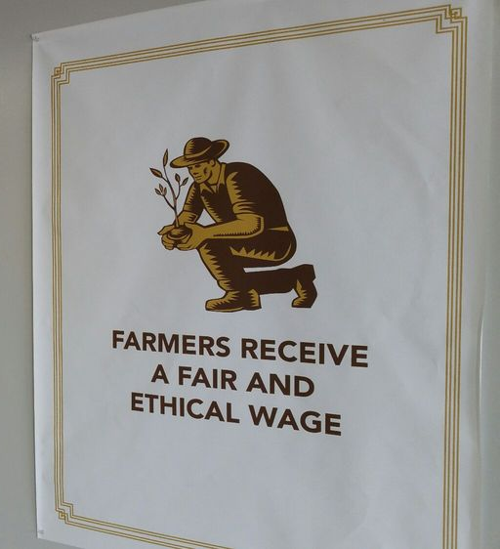
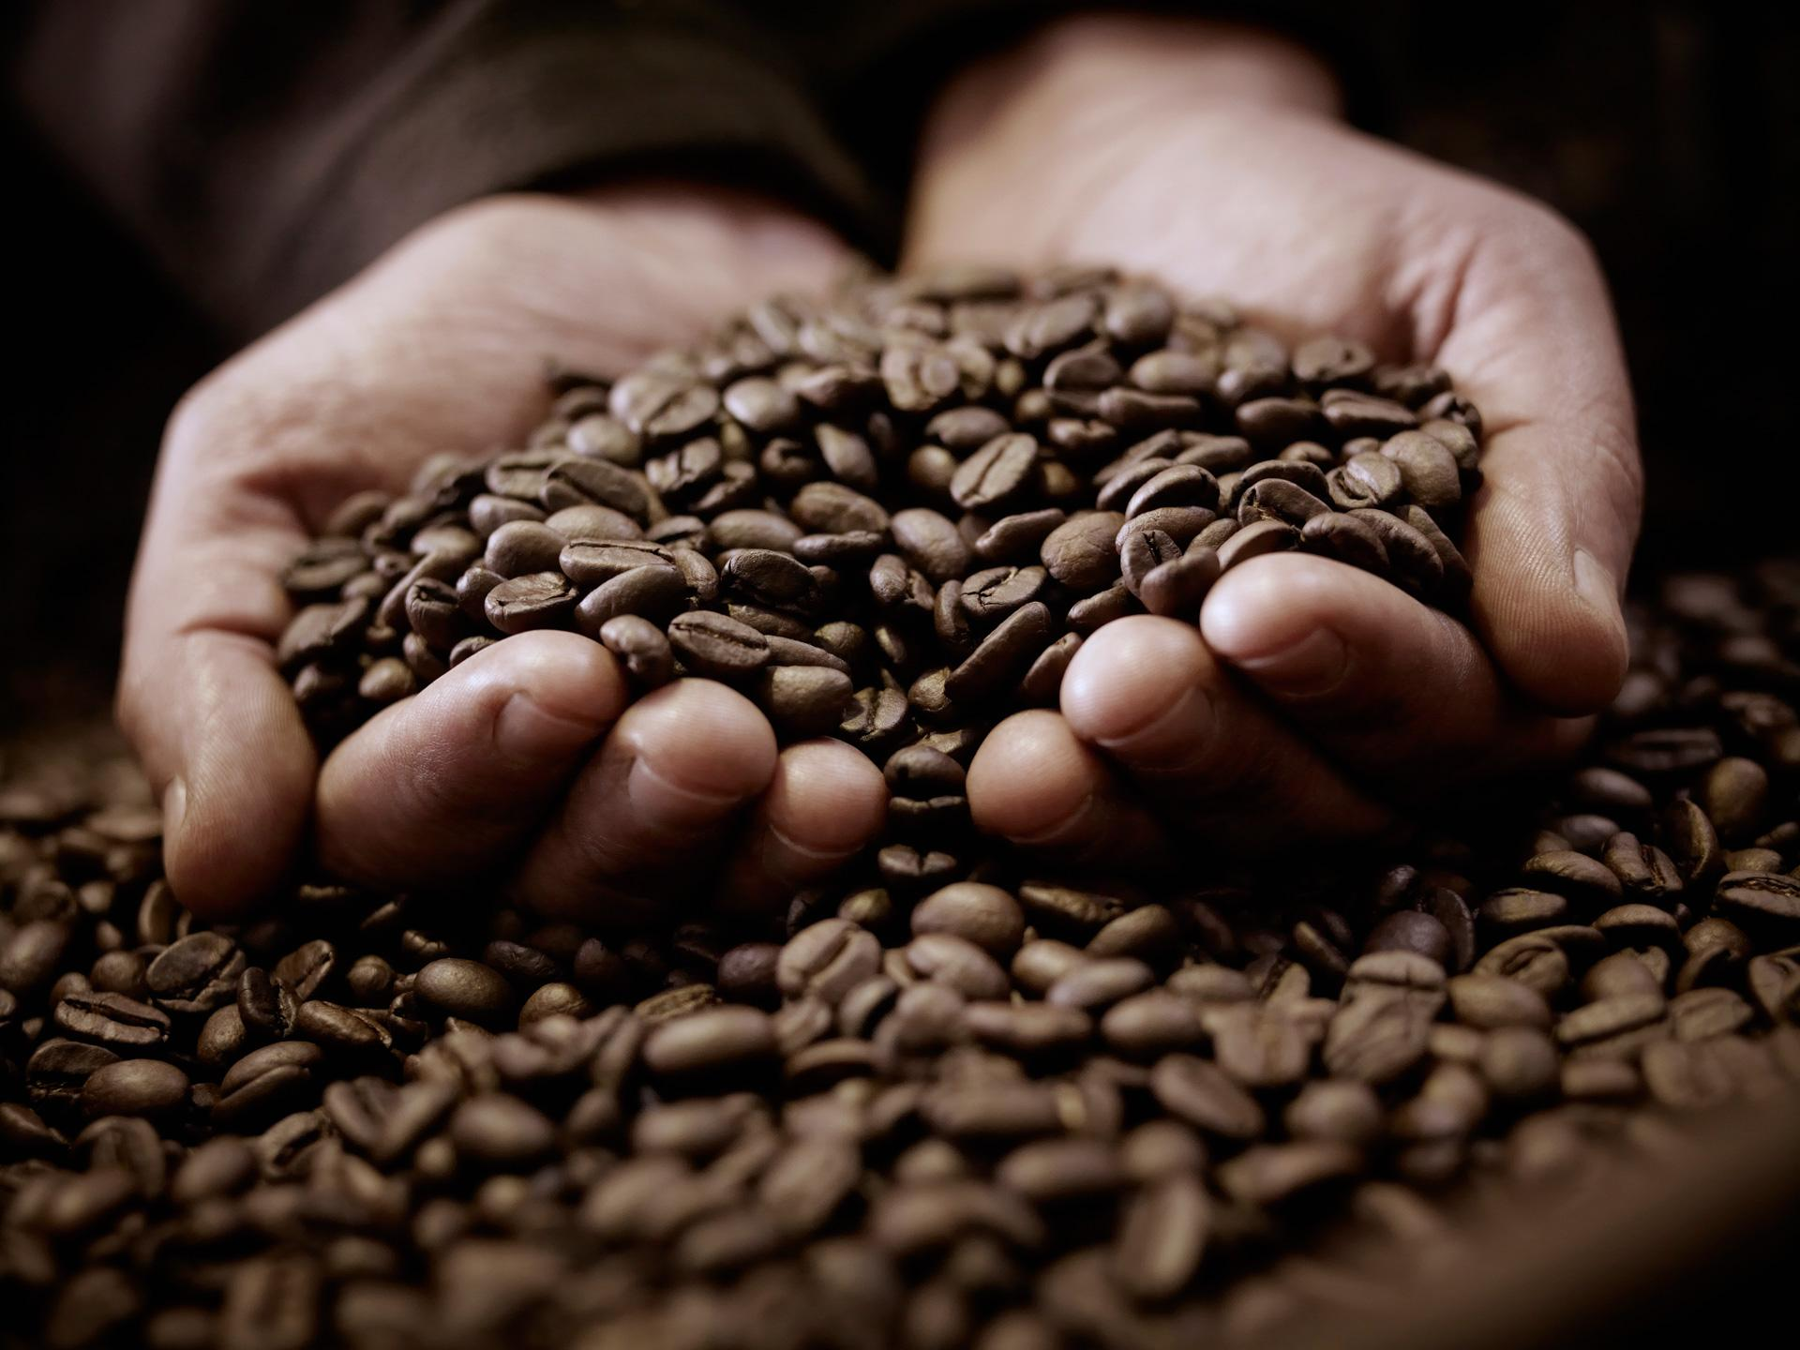
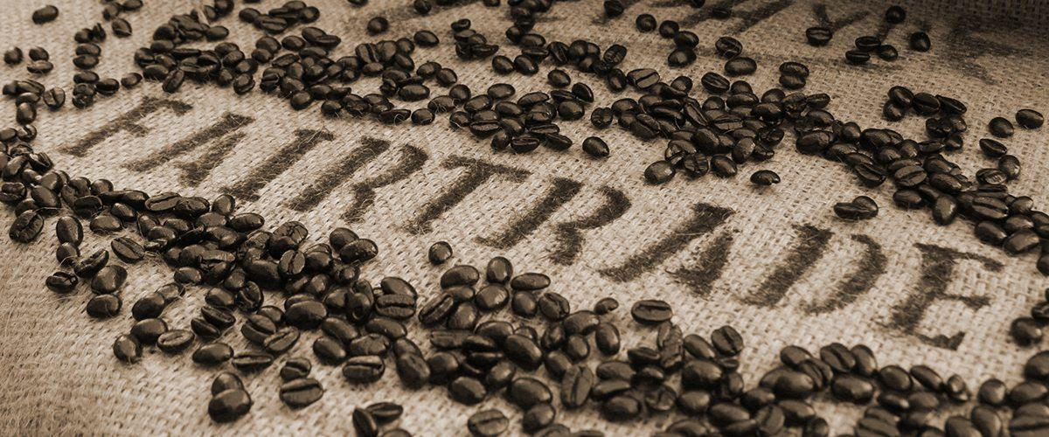
DISTRIBUTION AND SUPPLY CHAIN STRATEGY
Small Supply Chain
  Roaster located in Redlands, California
  Only deals with coffee beans that are fair or direct trade
  Ensure that coffee farmers receive an ethical wage
Break out of coffee shop of distribution and sell coffee beans online
  Problem is high shipping costs
  Planning to launch subscription strategy

Slide 17





PROMOTION STRATEGY
Word of mouth
Social Media
  Instagram
  Facebook
  Twitter
Student Discounts
Stamp Cards
  Stamped per visit
  Stamp is initialed by barista
  Free item after 10 stamps
  Can get 3 free drinks

Slide 18
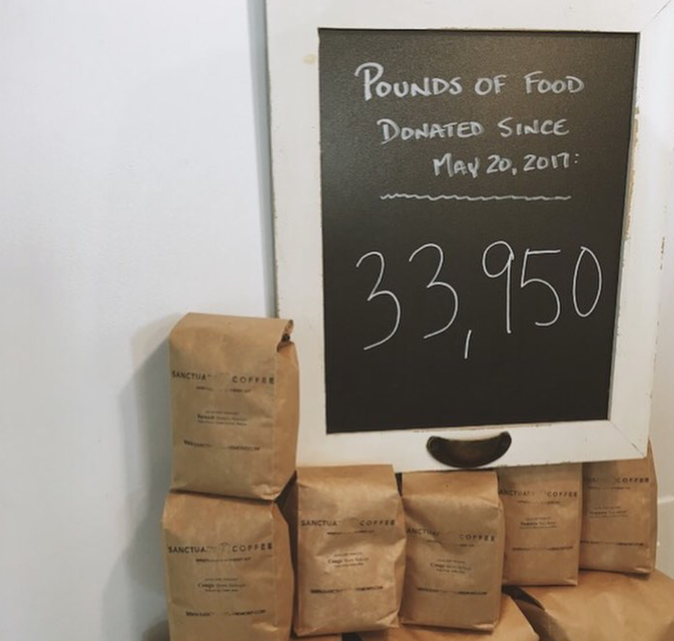


PUBLIC RELATION STRATEGY
Network with community leaders, pastors, clergy, civil leaders, police department, fire department, business leaders
Increase community involvement
Increase brand reputation, but most importantly raise awareness on social justice
100% of their profits goes to charities within the community
Roaster donates 10 pounds of food for every pound of coffee
  Donated almost 34,000 pounds of food
A little extra love in each cup will add up to one big donation at the end of the year!

Slide 19
CONSULTATION
TO THE
BUSINESS OWNER

Slide 20
RECOMMENDATIONS

Slide 21
THANK YOU

